Slide 1



Day 03
contact@anubhavtrainings.com
ABAP RESTFUL APPLICATION PROGRAMMING

Slide 2


Agenda – Day 03
Difference between On-premise and Cloud
Type of offerings
What is BTP
Using Eclipse Development Tool for ABAP Development
Create DB Tables using Eclipse
Load Sample Data to the demo Tables
Introduction to CDS Views Basics
Introduction to CDS entities
Describing AMDP with Use Case
Table function
Service Definition & Service Binding
Introduction to SAP Business Application Studio

Slide 3

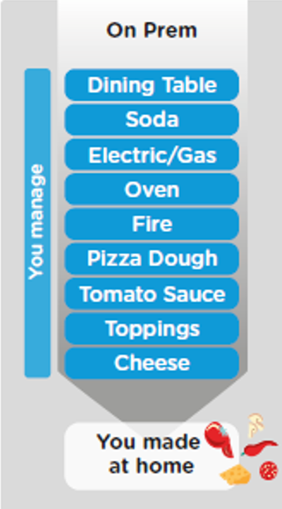
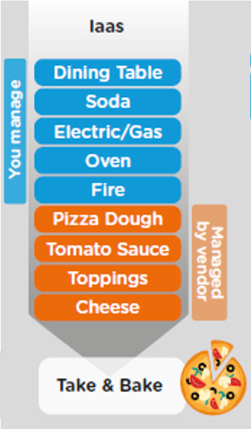
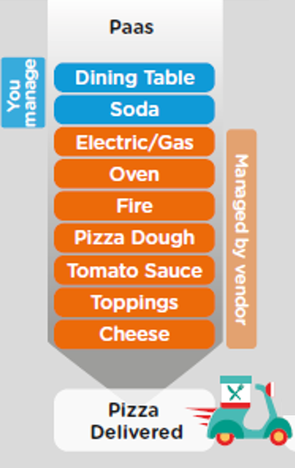
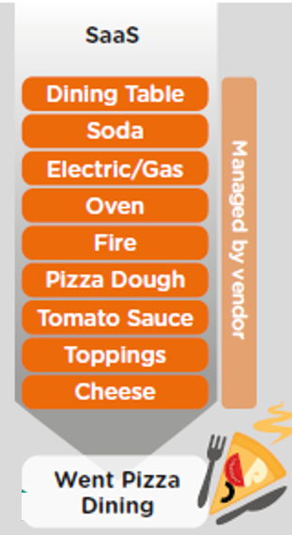
ON-PREMISE V/S CLOUD
www.anubhavtrainings.com

Slide 4
TYPE OF CLOUD OFFERINGS
Application
Application As a Service
Customer Managed
Customer Managed
Customer Managed
SAP Managed
Data
Runtime
Platform as a Service
SAP/Partner Managed
Middleware
Database
OS
Virtualization
Infrastructure as a Service
SAP/Partner Managed
Servers
Storage
Networking
www.anubhavtrainings.com

Slide 5
What is SAP BTP ?
SAP Business Technology Platform (SAP BTP) is the platform that powers you to become an intelligent enterprise through integration, extension, and data-to-value from all SAP and third-party application and data assets while ensuring your long-term success through agility, value-creation, and continual innovation.
BTP is an digital platform as a service to allow companies to build/integrate/extend existing solutions

Slide 6




WHAT IS SAP BTP?
Application
Application
Data
Data
Runtime
Platform as a Service
Managed by SAP implementing open source CF
Middleware
Fully ready landscape with reusable services
Scalability
Elasticity
Low TCO
Database
OS
Managed by Infrastructure
providers
Data Centers
Service Portfolio
Virtualization
Infrastructure as a Service
Servers
Storage
Networking
www.anubhavtrainings.com

Slide 7
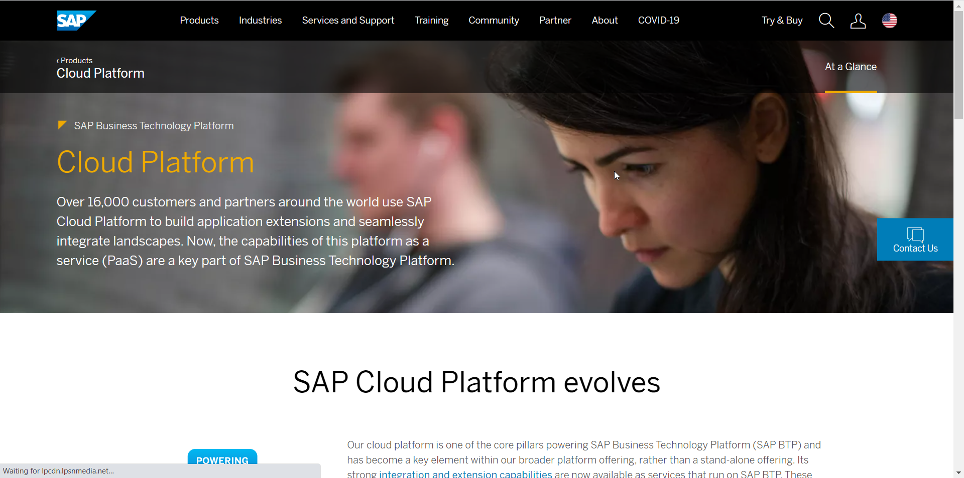
Setup Your FREE Account
https://account.hanatrial.ondemand.com/trial/#/home/trial
www.anubhavtrainings.com

Slide 8
Create Your DB Tables
Business Partner
Sales Order Header
Sales Order Items
1..1
1..*
Product
1..1
Exercise
Create Data elements & Domain for ID (Char32) and Role (Char2)
Create Database Tables
Load Data to the table

Slide 9
Creating CDS View
ZATS_00_C_SOFTSALES
ZATS_00_I_BP
ZATS_00__I_SALES
ZATS_00_SO_I
0..1
ZATS_00_BP
0..1
ZATS_00_I_SALESHDR
ZATS_00_P_PROD
0..1
ZATS_00_SO
ZATS_00_Product
Exercise
Create CDS View According to VDM

Slide 10
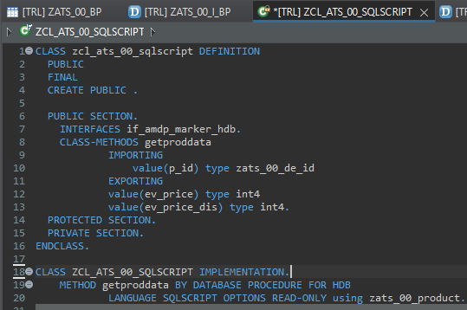
Describing AMDP
ABAP Managed Database Procedures (AMDP) are the preferred way for developing SAP HANA DB procedures on the ABAP platform. Since ABAP Managed Database Procedures are implemented as methods of a global ABAP class, the editing environment for AMDP is the ABAP class editor.
Requirement 1: Pass the product id, system should calculate the discounted price and return
actual and discounted price.
There are 2 types of SQL Script contains:-
Procedure - can have multiple return values
Function - always have one return value
Exercise
Create AMDP

Slide 11
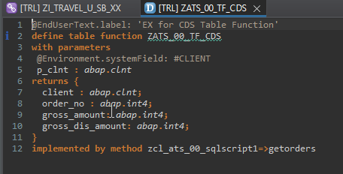
Creating Table Function
A CDS table function is defined using the ABAP CDS statement DEFINE TABLE FUNCTION and can be used as the data source in Open SQL read statements.
Each CDS table function includes the following components:
The actual CDS entity of the table function that is generated in the ABAP Dictionary
The CDS table function implementation (ABAP class library)
Requirement 2: return all the sales order no, amount (actual), discounted amount of sales orders]
Exercise
Create Table Function

Slide 12
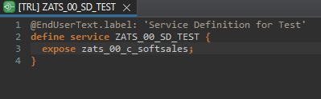
Service Definition
The service definition is a projection of the models and related behavior that you want to expose. In a service definition, you define the OData service to determine which CDS entities are part of the service. This service is then bound to a protocol and to either a UI technology or an A2X service by a service binding artifact. A service definition can be integrated in various protocols without any reimplementation.
Exercise
Service Definition

Slide 13
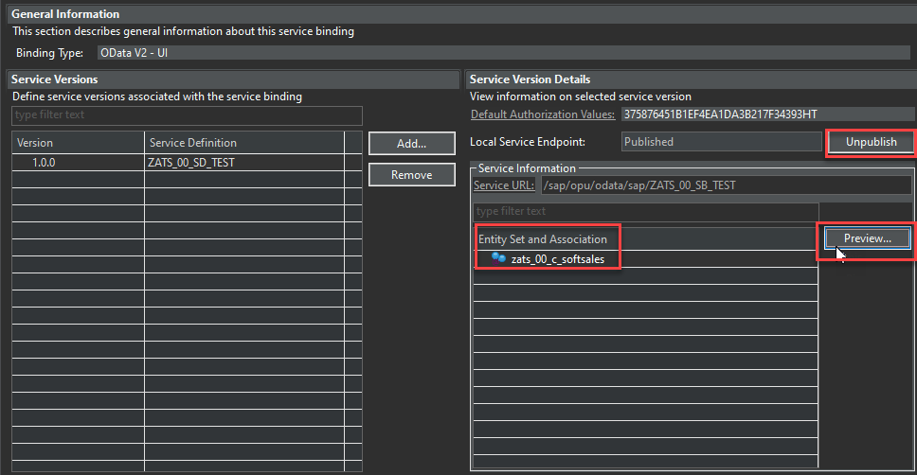
Service Binding
A service binding implements the protocol that is used for the OData service. It uses a service definition that projects the data models and their related behaviors to the service.

Slide 14
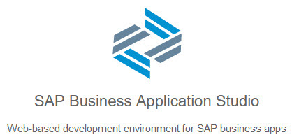
BAS Introduction
SAP Business Application Studio is a new SAP Business Technology Platform (BTP) service that offers a modern development environment tailored for efficient development of business applications for the SAP Intelligent Enterprise.
SAP Business Application Studio provides a tailor-made development environment for various development scenarios, such as SAP Fiori, SAP S/4HANA extension, and Workflow. With each of these scenarios, you can create different types of applications.
These tools cover the end-to-end development cycle:
Clone an existing project with a Git client or create new project using templates.
Use editors for SAP-specific technologies.
Easily test your application on your dev space while consuming services from remote sources.
Build and deploy the application as a multitarget application (MTA).

Slide 15
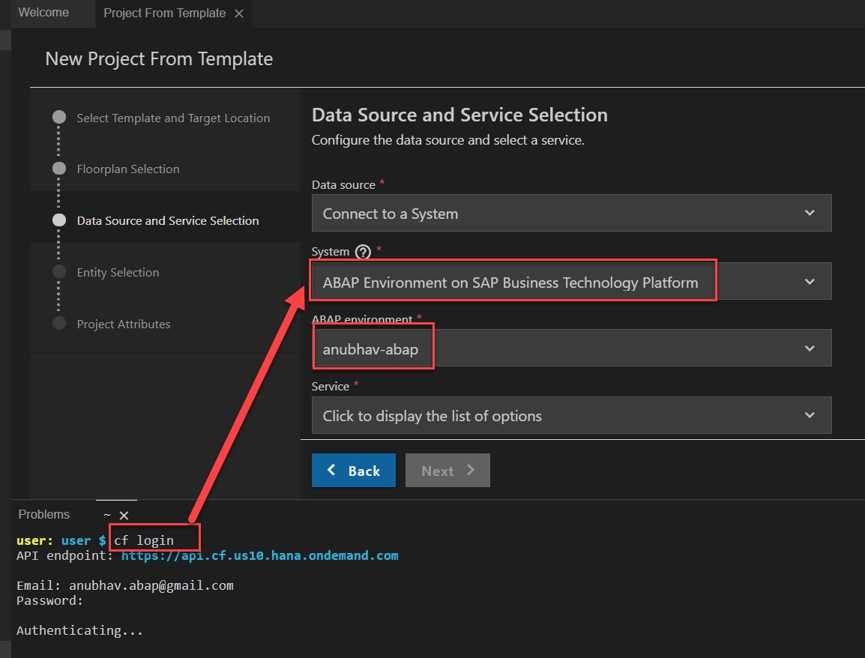
Creating Fiori App on BAS
Creating Fiori App on BAS Using Service on Top of CDS Model.
First Login Cloud Foundry ( cf login ).
Select System ABAP Environment on SAP BTP.

Slide 16
Important Table’s
CDS Views on these table for ease of access
Database tables
Represents entire aviation tourism
/DMO/CARRIER– Contains all the airline codes
I_Currency
CDS view to access currency codes
/DMO/AGENCY
Agent information website/person who helps
/DMO/CONNECTION– FLIGHT infor from origin to destination
I_Country
Country codes
/DMO/TRAVEL
Trip information
/dmo/flight– given flight for diff. dates
/DMO/CUSTOMER
Customer data who willing to book flights
/DMO/BOOKING
Connecting flights in whole travel

Slide 17

End of Day 03
Trainer: Anubhav Oberoy

Slide 18

Trainer: Anubhav Oberoy

Slide 19
THANK YOU
If you cannot do
great things, do small things in a great way.
Anubhav Oberoy
https://www.anubhavtrainings.com

Slide 20


We’re committed to empower you to be
Most Desirable Resource
through powerful training solutions.
We build the workforce of the future.
250+
Corporate Clients
30,000+
Learners Trained
25000+
Learners Placed
FREE WEBINARS
Sign up for free webinars with industry experts every fortnight!
Enroll Now!
Contact us today!
https://anubhavtrainings.com/

Slide 21




More from AnubhavTrainings.com

